Slide 1
Argo
Effect of abuse on characters and society

Slide 2
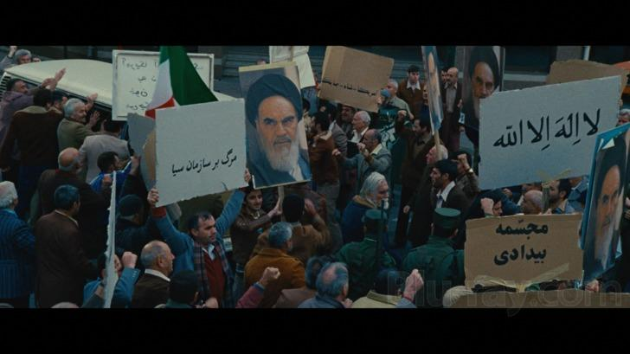
Article 3
The whole of America was enraged at the fact that their fellow Americans were killed and/or taken hostage
Everyone was afraid to go Iran to because they know they weren’t welcomed there
The media had an effect on this because it showed the Americans back home what the situation in Iran was
The six Americans that survived were afraid to leave or show their face because they will be caught and killed
The society in Iran were affected by the killings by having riots and spreading propaganda

Slide 3
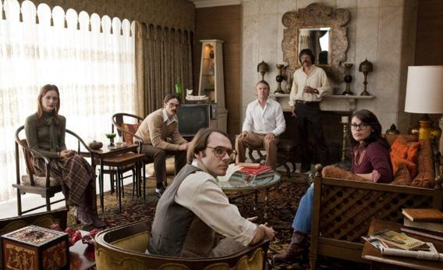
Article 13 and 14
The six American diplomats that survived were very scared because they were stuck in a country where they could be killed at any given moment
They were also very stressed because they just wanted to leave but were not able to

Slide 4
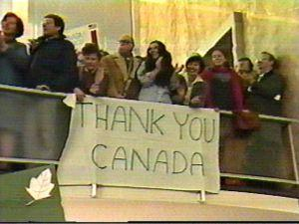
Article 15
The diplomats had to change their whole identity which was not easy and very overwhelming for them (Disguised as Canadians)
At the end, when the Iranians discovered their real identity, they felt fooled and angry. They had to capture them at any cost

